Slide 1

MILESTONE-2
Global Economic and Demographic Trends Analysis
SANJAIKUMAR S
DA&DS
FEBRUARY 2025
27-05-2025

Slide 2
OBJECTIVE
Understand global development through GDP growth, population dynamics, and literacy trends.
Analyze birth/death rates to assess economic stability and sustainability.
Compare GDP per capita and living standards across regions.
Use interactive dashboards for data-driven decision-making.

Slide 3
DATASET OVERVIEW
Data Sources:
Countries World – MySQL
Meta Data Country – CSV
Population Per Country – CSV
GDP 1960–2016 – Excel
Key Features: Covers 190+ countries, multiple indicators from 1960–2016.

Slide 4

Tools Used:
MySQL (Queries, Joins)
Power BI (Data Modeling, Visualizations)
Steps Involved:
Cleaning (missing, duplicates)
Statistics (Descriptive Analysis)
Merging Tables
DAX calculations
Visualizations
Insight generation

Slide 5
Descriptive Statistical Analysis
Population: Mean, Median, Mode, Std Dev across countries.
GDP: Country-wise average GDP per capita.
Infant Mortality: Min, Max, Std Dev.
Literacy: Region-wise literacy rate averages

Slide 6
Dax Calculations
Population Growth Rate = Year-over-Year % increase
GDP Growth Rate = CAGR / YoY growth
GDP per Capita = GDP / Population
Regional Aggregations = SUMX by region
Correlation Metrics = Literacy ↔ GDP insights

Slide 7
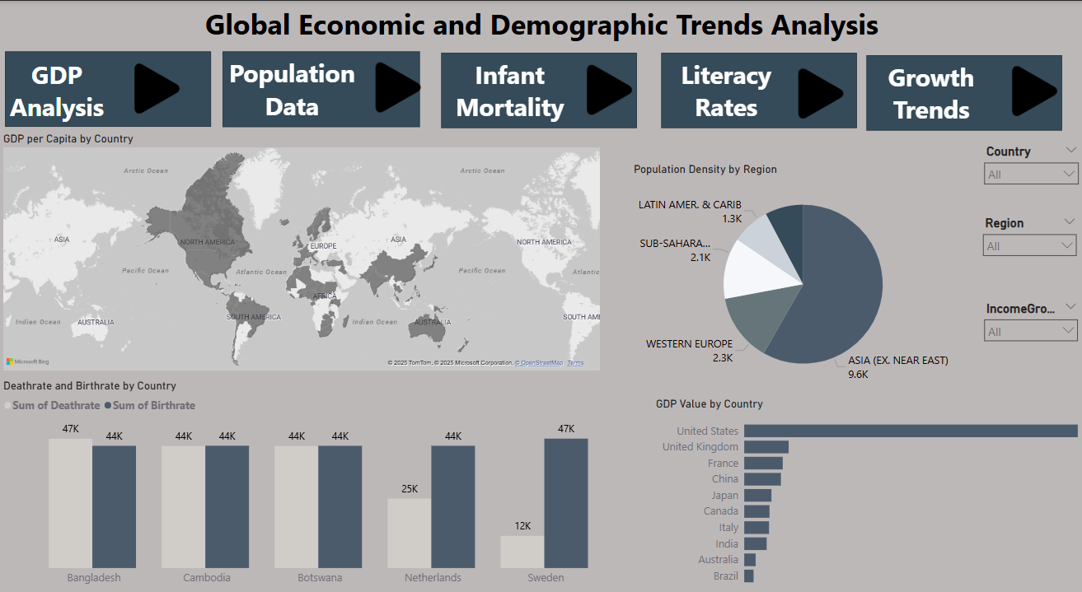


Slide 8
Key Insights
Highest GDP/Capita: Luxembourg ($55,100)
Lowest GDP/Capita: East Timor, Sierra Leone, Somalia ($500)
Infant Mortality:
Lowest: East Timor
Highest: American Samoa
Population Leaders:
China (1.3B), India (1.0B), USA, Indonesia, Brazil

Slide 9
Recommendations
Healthcare: Strengthen in high mortality regions.
GDP Improvement:
Boost infrastructure
Support local industries
Encourage foreign investment
Education Focus:
More schools in rural areas
Improve literacy for economic impact

Slide 10
Conclusion
The project provides deep insights into economic and demographic indicators globally.
Highlights disparities and strengths across regions.
Power BI visualizations helped identify trends and support strategic decisions.
These insights can guide policymaking, economic planning, and development strategies.

Slide 11

Thank you

